Slide 1
Hotel managed system
Professor: han hong lu
Students: tan tho Nguyen – 986205
Tuan sang tran – 985661
Le cat vy Nguyen - 986177

Slide 2
description
We are going to build a hotel manage system that client/admin be able to do:
Book the room (based on price, type, date). – Vy Nguyen
View booking (cancel, update). – Vy Nguyen
Payment. (Pay, add new card) – Vy Nguyen
Register. – Tan Tho Nguyen
Log in/ log out to the system. – Tan Tho Nguyen
Search room. – Tuan Sang Tran
Provide promotion to client. – Tuan Sang Tran
View user profile. – Tan Tho Nguyen
We will build the application after that we will apply the patterns to our application.

Slide 3
Design framework
The framework is based on ‘hotel managed system’ application to give the structure for any service system (spa zone, hotel, motel, renting…) using it and develop new application based on their business easily. It is called ‘service system’ framework.

Slide 4


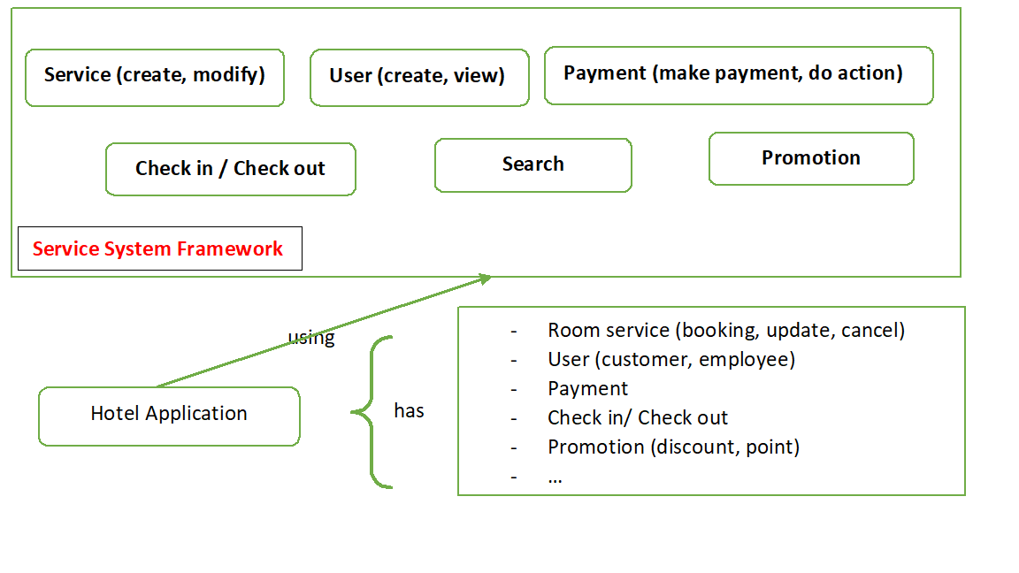
Framework structure

Slide 5
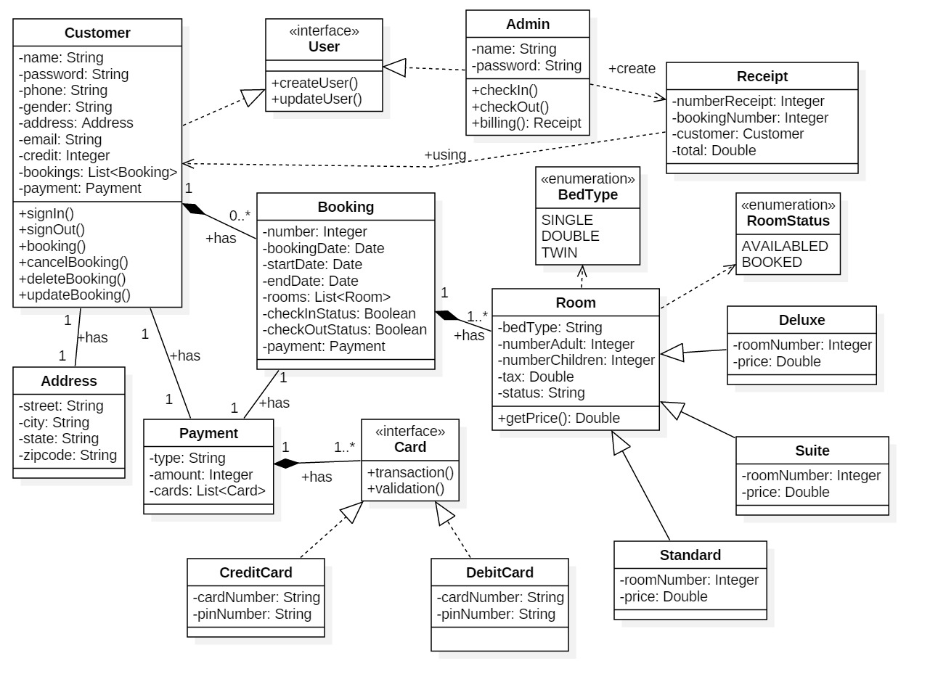
Application class diagram

Slide 6
Technical using
Java core
Spring boot framework (for connecting to database)
My sql
Java fx

Slide 7
Apply design pattern
Register component: proxy
Create user: strategy
View user information: template
Promotion: command, prototype, mediator, factory method, singleton
Booking: builder
Calculate price of booking: visitor
Add new card: factory (included singleton)

Slide 8
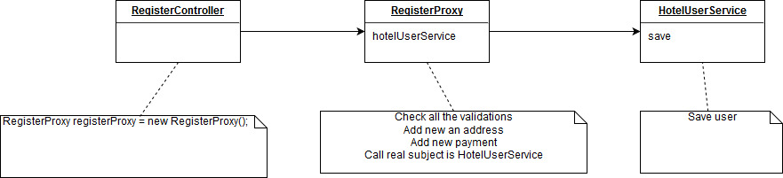
Register diagram (proxy pattern)

Slide 9
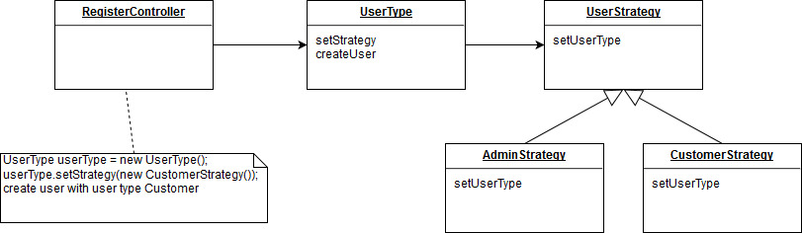
Create user diagram (strategy pattern)

Slide 10
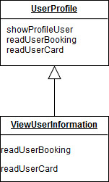
View user information diagram (template pattern)

Slide 11
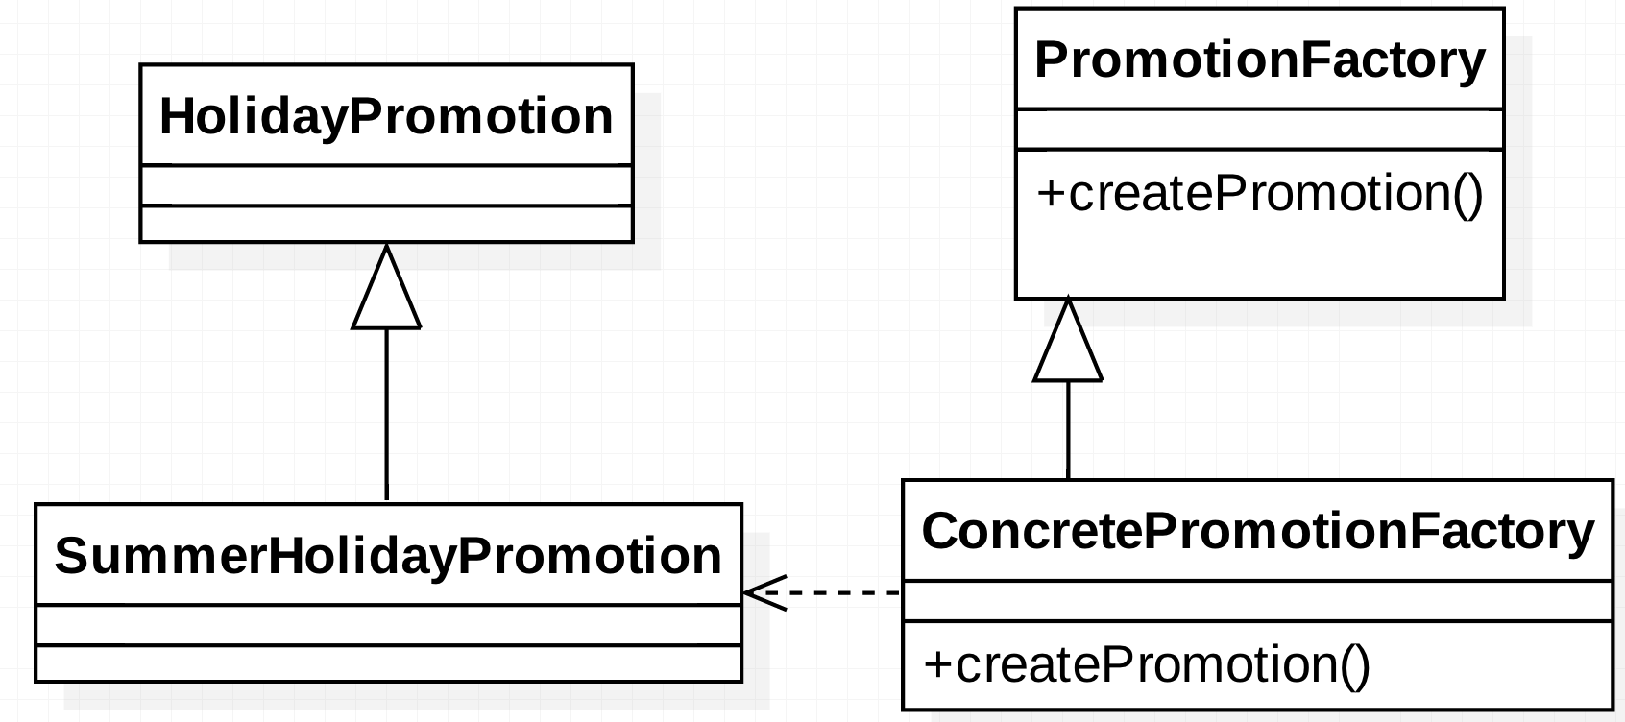
Create 4 type of Promotion diagram (Factory pattern)

Slide 12
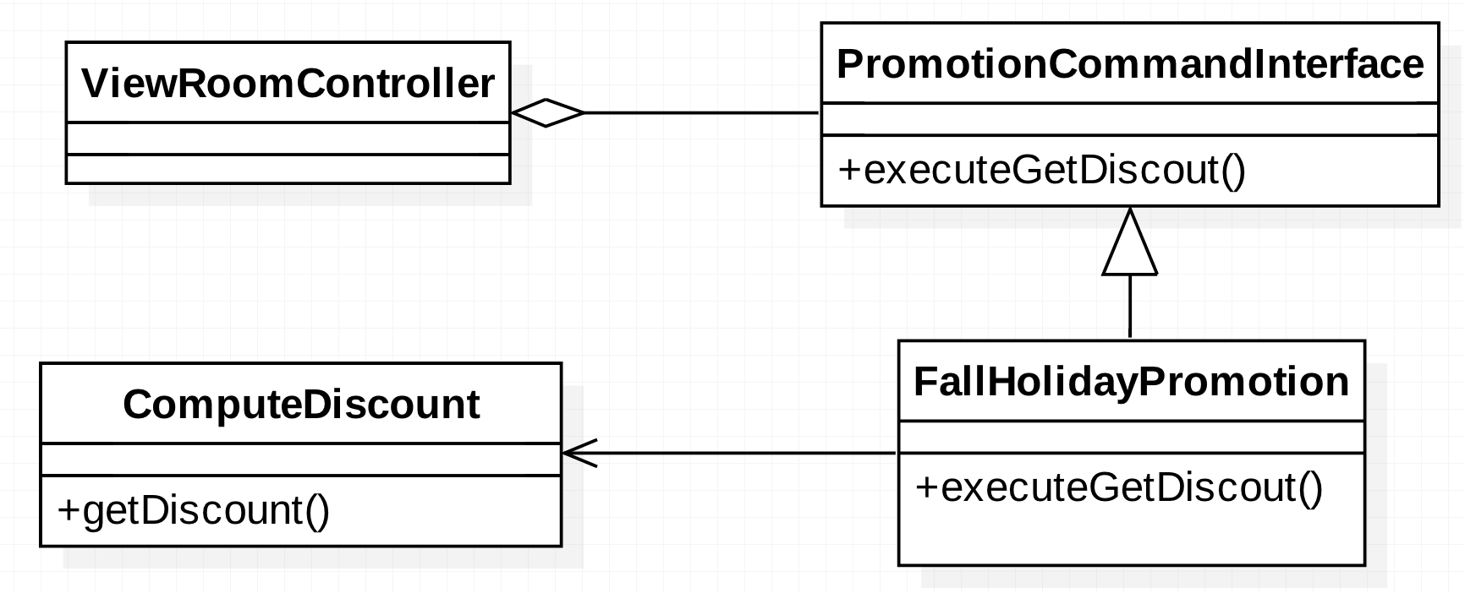
Compute Promotion type discount diagram (Command pattern)

Slide 13
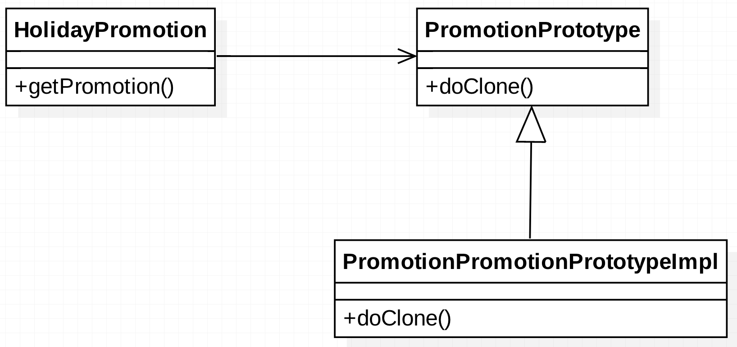
Clone Promotion diagram (Prototype pattern)

Slide 14
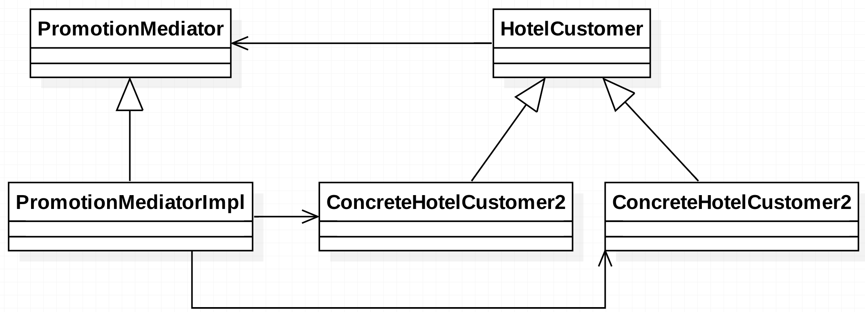
System Initialize and Broadcast Promotion diagram (Mediator pattern)

Slide 15
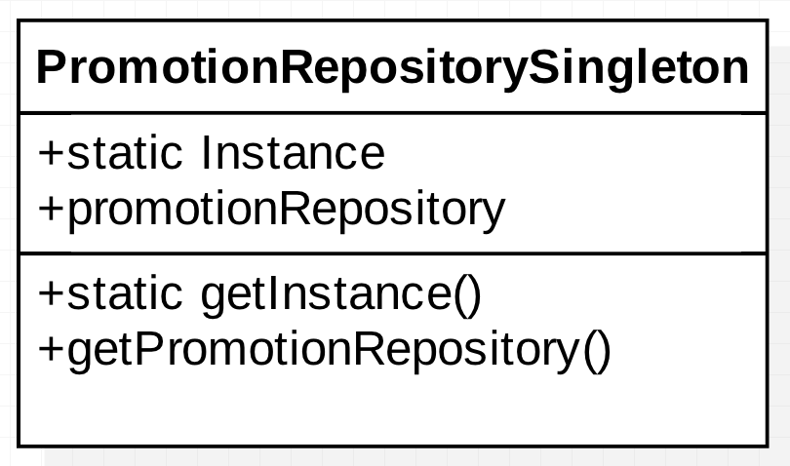
SingleTon PromotionRepository diagram (Singleton pattern)

Slide 16
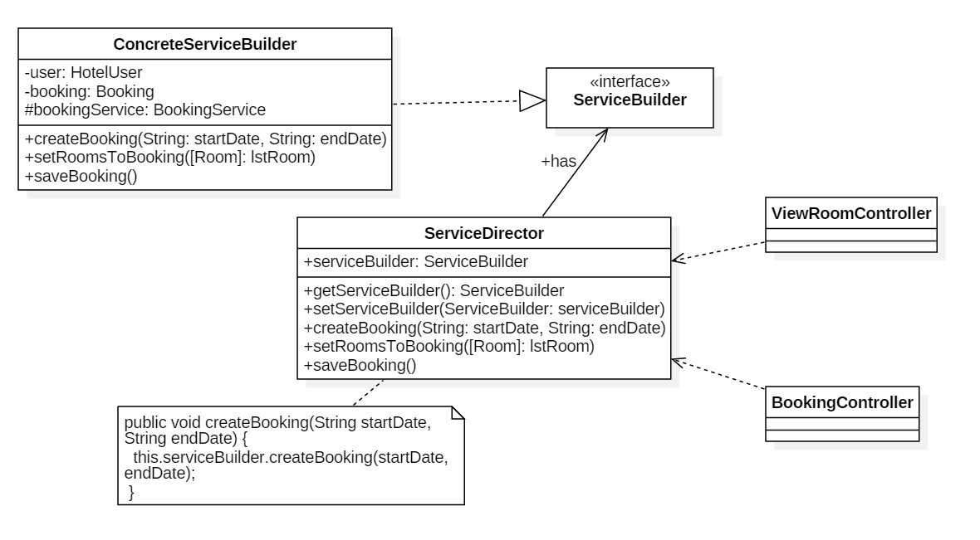
Booking diagram (builder pattern)

Slide 17
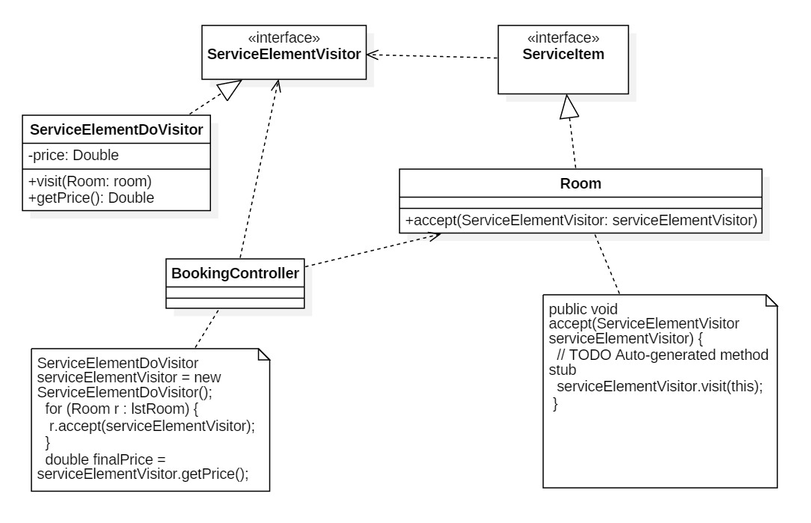
Calculate price diagram (visitor pattern)

Slide 18
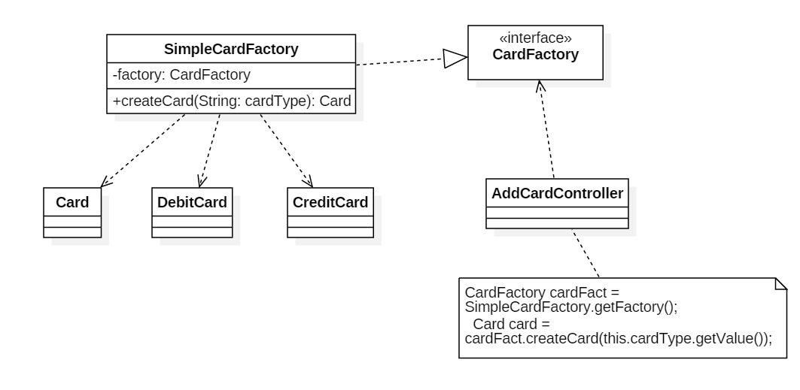
Add card diagram (factory pattern)

Slide 19
info
Demo
Q&A
Github link: https://github.Com/thonguyen1302/projectasd_design_pattern
THANK YOU

